Slide 1

Bayesian Uncertainty Quantification of Physical Models in Thermal-Hydraulics System Codes
Damar Wicaksono (Thesis Directors: Prof. A. Pautz & Mr. O. Zerkak)
PhD Defense, EPF Lausanne, 19.01.2018

Slide 2
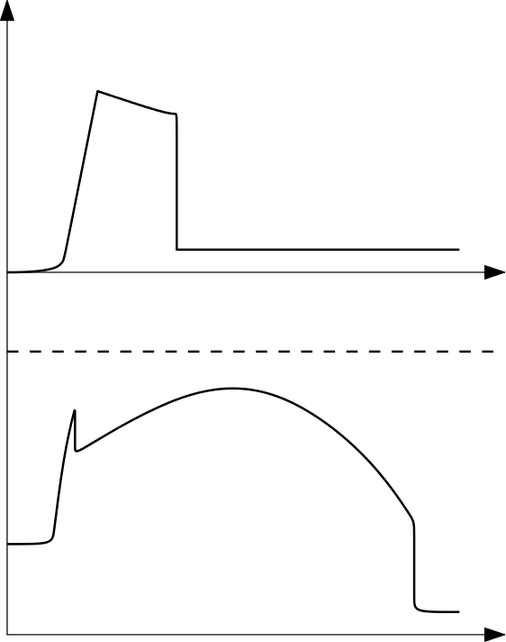
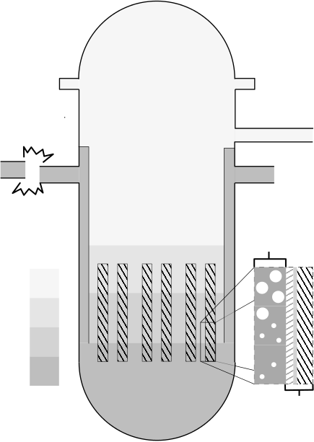
Safety Analysis of LWR under LBLOCA: Show max. clad temperature < safety limit
Reactor Pressure Vessel
ECC Mass Injection
Accumulator
Double-ended
Guillotine Break
Hot Leg
Low Pressure Injection
Cold Leg
Emergency Core Cooling
Clad Temperature
Two-phase
hydraulics
Safety Limit
Reactor Core
Gas Phase
Liquid Phase
Heat conduction through solids
Time
Notes:
Motivation: Safety Analysis of NPP under LBLOCA

Slide 3
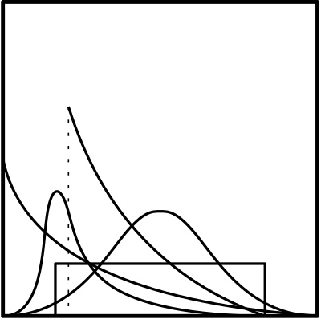
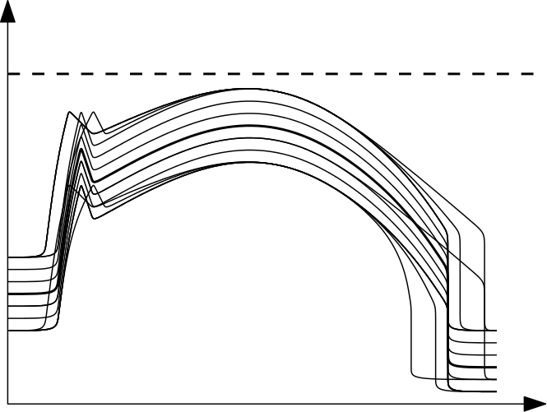
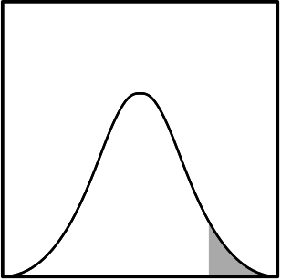

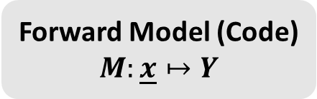
Forward Uncertainty Quantification: Uncertain Inputs $⇒$ Uncertain Outputs
Monte Carlo simulation (multiple code runs)
Forward Model (Code) $$M:\underline{x}↦Y$$
Statistical Analysis of ``Quantities of Interest’’
Uncertain Inputs
(random variables)
Safety Limit
e.g., PCT
Material properties
Initial conditions
Boundary conditions
Physical model parameters
Clad Temperature
Uncertain Outputs
Decision Making
Safe/Fail, Accept/Reject, etc.
Notes:
This is statistical (probabilistic) framework

Slide 4

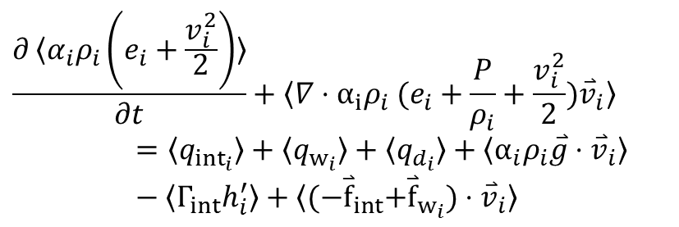
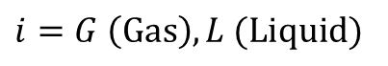
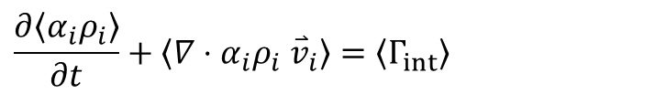
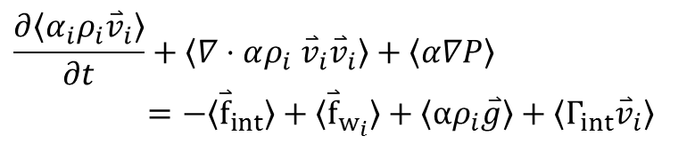
Physical Model Parameters: post-Critical Heat Flux (CHF) Flow Regimes
Mass
Closure Laws
pre-CHF
(Steam Convection)
Parametric
models
$$\frac{∂〈α_{i}ρ_{i}〉}{∂t}+〈∇⋅α_{i}ρ_{i} {\overset{⃑}{v}}_{i}〉=〈Γ_{int}〉$$
Dispersed Flow Film Boiling (DFFB)
Momentum
$$\frac{∂〈α_{i}ρ_{i}{\overset{⃑}{v}}_{i}〉}{∂t}+〈∇⋅αρ_{i} {\overset{⃑}{v}}_{i}{\overset{⃑}{v}}_{i}〉+〈α∇P〉=−〈{\overset{⃑}{f}}_{int}〉+〈{\overset{⃑}{f}}_{w_{i}}〉+〈αρ_{i}\overset{⃑}{g}〉+〈Γ_{int}{\overset{⃑}{v}}_{i}〉$$
Interpolatory (Inverted Slug)
Energy
$$\frac{∂〈α_{i}ρ_{i}\left(e_{i}+\frac{v_{i}^{2}}{2}\right)〉}{∂t}+〈∇⋅α_{i}ρ_{i} (e_{i}+\frac{P}{ρ_{i}}+{\frac{v_{i}^{2}}{2})\overset{⃑}{v}}_{i}〉=〈q_{{int}_{i}}〉+〈q_{w_{i}}〉+〈q_{d_{i}}〉+〈α_{i}ρ_{i}\overset{⃑}{g}⋅{\overset{⃑}{v}}_{i}〉−〈Γ_{int}h_{i}^{′}〉+〈{(−\overset{⃑}{f}}_{int}+{\overset{⃑}{f}}_{w_{i}})⋅{\overset{⃑}{v}}_{i}〉$$
Inverted Annular Film Boiling (IAFB)
Transition Boiling
pre-CHF
(Nucleate Boiling)
$$i=G \left(Gas\right), L (Liquid)$$
Notes:
What are these physical model parameters?
Take for example the phenomenological models that describe two phase flow during a reflood of a dry channel
Closure laws describe the interaction between phases in each distinct **pre-determined** flow regime

Slide 5
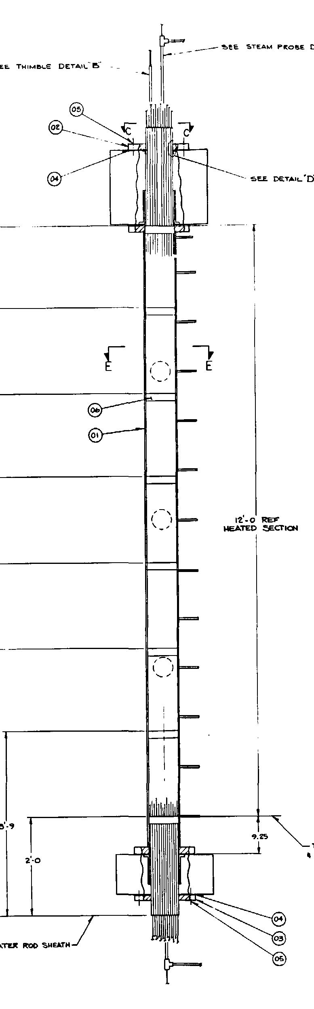
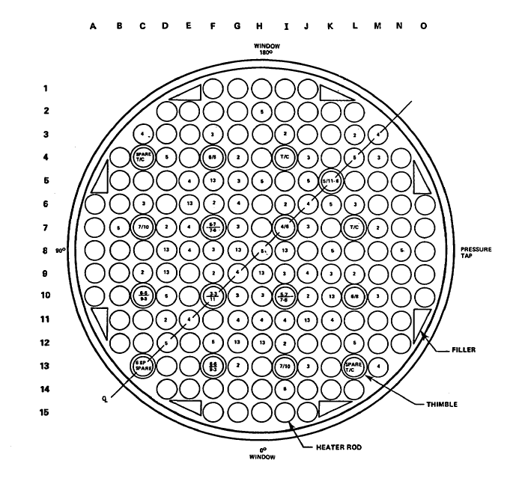
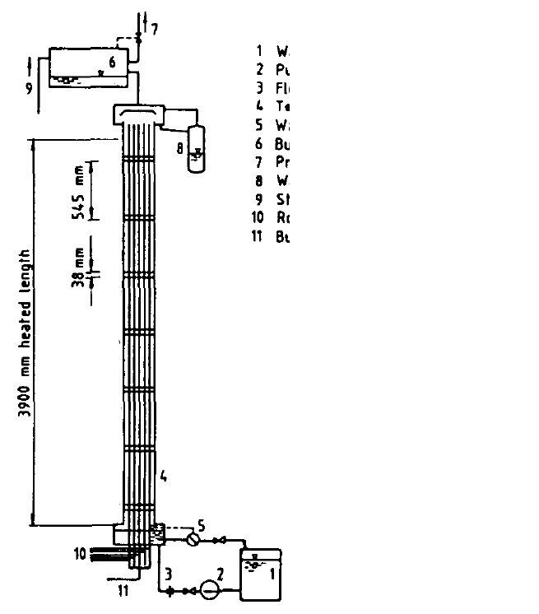
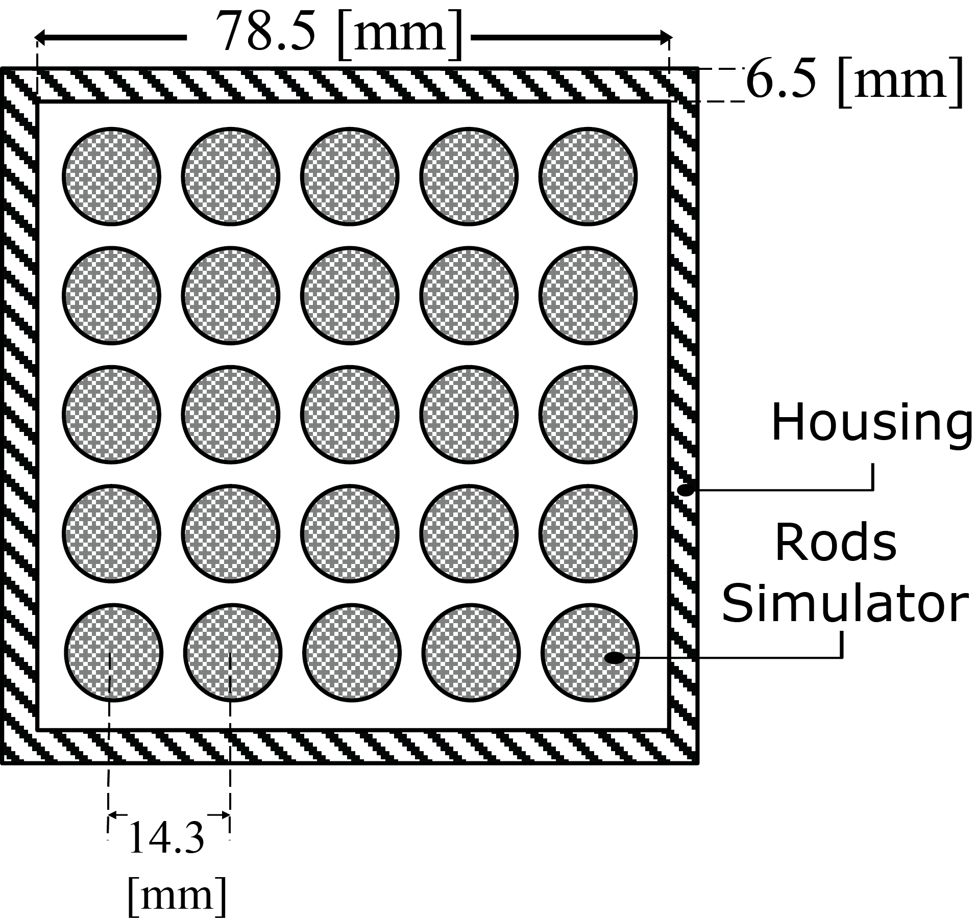
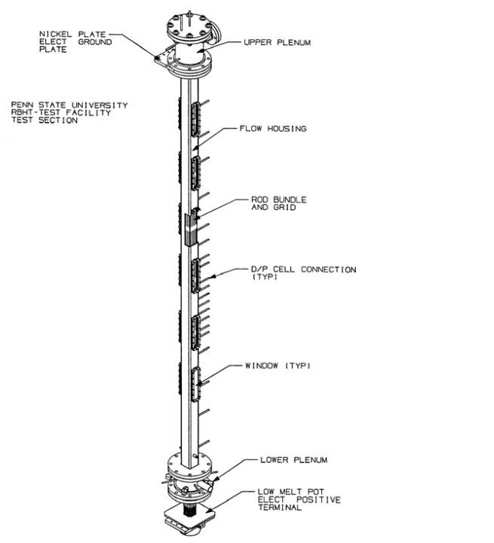
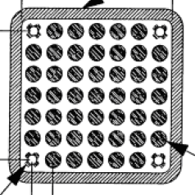
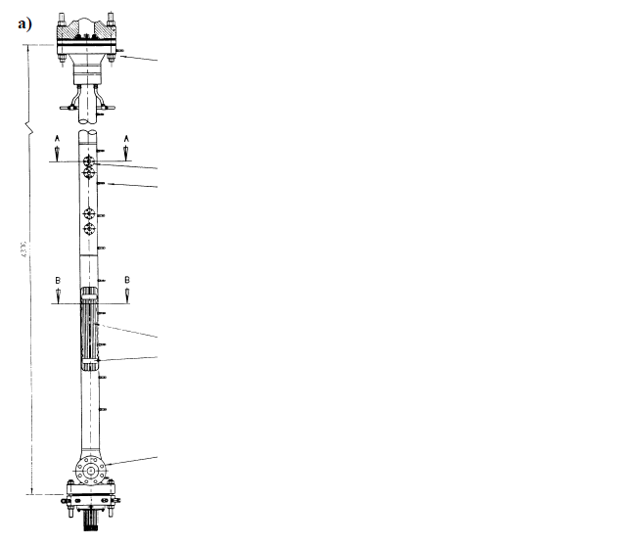
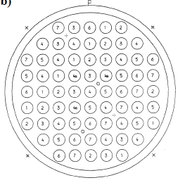
Uncertainty in Physical Model Parameters
Excerpt from the TRACE Code Theory Manual:
“…the approximate value of the coefficient in Eq. (4-119) was determined from data comparisons with FLECHT-SEASET high flooding rate reflood data…” (pp. 164)
“In TRACE, the above interfacial drag coefficient has been reduced by a factor of ¾ to better match FLECHT-SEASET high flooding rate reflood data, so…” (pp. 166)
FLECHT-SEASET
Westinghouse, USA
What if the calibration was done on other, similar, separate effect test facilities (SETFs)?
FEBA
KIT, Germany
RBHT
PSU, USA
ACHILLES
Winfrith, UK
Notes:
Where is this uncertainty coming from

Slide 6
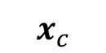
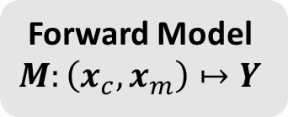
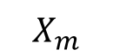

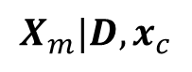
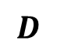
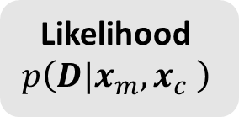
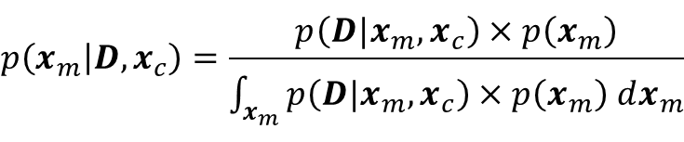
Inverse Uncertainty Quantification: Uncertain (Inputs+Data) $⇒$Uncertain Inputs Updated
Experimental Data from SETF
$$D$$
Probability of observing data given parameters
Controllable inputs (w.r.t experiment)
$$x_{c}$$
Forward Model $$M:\left(x_{c},x_{m}\right)↦Y$$
Likelihood $$p\left(D|{x_{m},x}_{c} \right)$$
$$X_{m}|D,x_{c}$$
$$X_{m}$$
Uncertain model parameters (prior)
Uncertain model parameters (posterior)
Additional sources of uncertainty
Bayes’
Theorem
$$p\left(x_{m} | D,x_{c}\right)=\frac{p\left(D|x_{m},x_{c}\right)×p\left(x_{m}\right)}{\int_{x_{m}}{p\left(D|x_{m},x_{c}\right)×p\left(x_{m}\right) dx_{m}}}$$

Slide 7
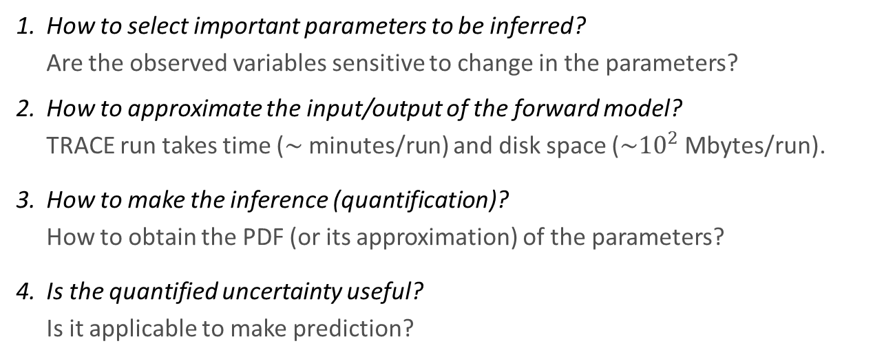
Research Objectives
Given experimental data from a Separate Effect Test Facility (SETF), develop a methodology to:
Quantify the uncertainty of physical model parameters in a TH System Code
to be sampled from and propagated within statistical uncertainty analysis framework.
Cast as a problem of statistical inference and entails four main questions:
How to select important parameters to be inferred? Are the observed variables sensitive to change in the parameters?
How to approximate the input/output of the forward model? TRACE run takes time ($\sim$minutes/run) and disk space ($\sim {10}^{2}$Mbytes/run).
How to make the inference (quantification)? How to obtain the PDF (or its approximation) of the parameters?
Is the quantified uncertainty useful? Is it applicable to make prediction?

Slide 8
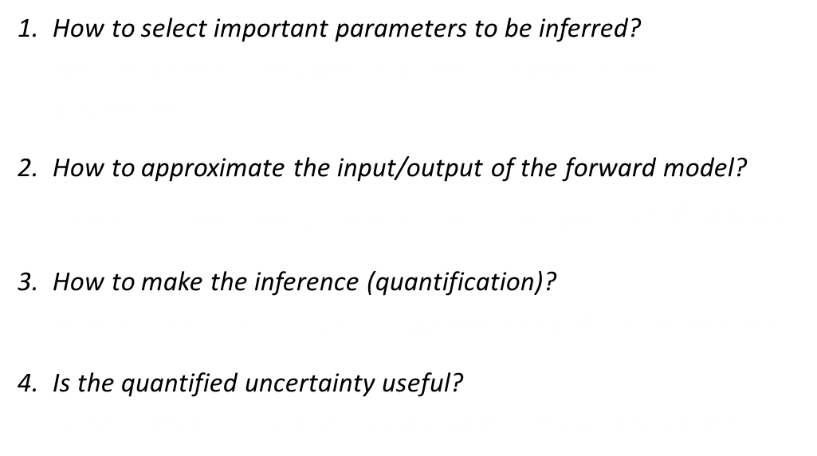
Scope of Research: Statistical Framework
How to select important parameters to be inferred? Are the observed variables sensitive to change in the parameters?
How to approximate the input/output of the forward model? TRACE run takes time ($\sim$minutes) and disk space ($\sim {10}^{2}$MBytes).
How to make the inference (quantification)? How to obtain the PDF (or its approximation) of the parameters?
Is the quantified uncertainty useful? Is the quantified uncertainty applicable to make prediction?
Global Sensitivity Analysis
Gaussian Process Metamodeling
Bayesian Calibration
Uncertainty Propagation
Methods are non-intrusive
Methods require less assumptions about the underlying model
Ultimate results conform with probabilistic framework for UQ
Methods tends to be expensive (require numerous code runs)
Notes:
To answer those questions, we adapt and implement statistical methodologies derived from applied statistics especially related to the design and analysis of computer experiments.
This will also serve as the outline for the rest of the presentation we will start answering these questions one by one using a running example of TRACE model.
And we don’t develop codes, it is worthwhile to develop methods that is applied outside the code implementation.

Slide 9
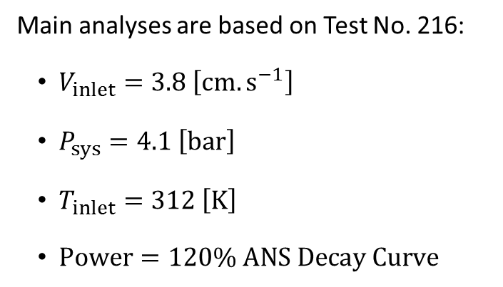
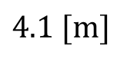
Scope of Research: FEBA Separate Effect Test Facility (SETF)
FEBA Reflood Tests were conducted at Kfz Karlsruhe (KIT) during 1980s for investigating bottom reflood using rod simulators (NiCr)
Main analyses are based on Test No. 216:
$V_{inlet}=3.8 \left[cm.s^{−1}\right]$
$P_{sys}=4.1 \left[bar\right]$
$T_{inlet}=312 \left[K\right]$
$Power=120\% ANS Decay Curve$
$$4.1 [m]$$
Three types of measurements were taken:
Clad temperature (8 axial locations)
Pressure drop (4 axial segments)
Liquid carryover
Notes:
The method is adapted and demonstrated directly to solve this problem.
The problem is used in the OECD/NEA PREMIUM Benchmark

Slide 10
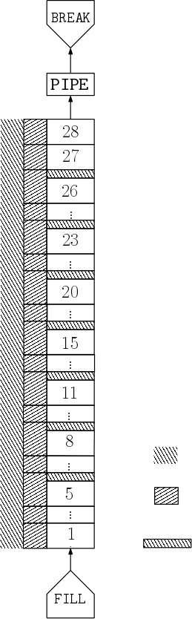
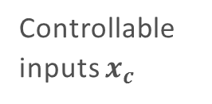
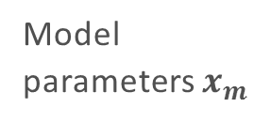
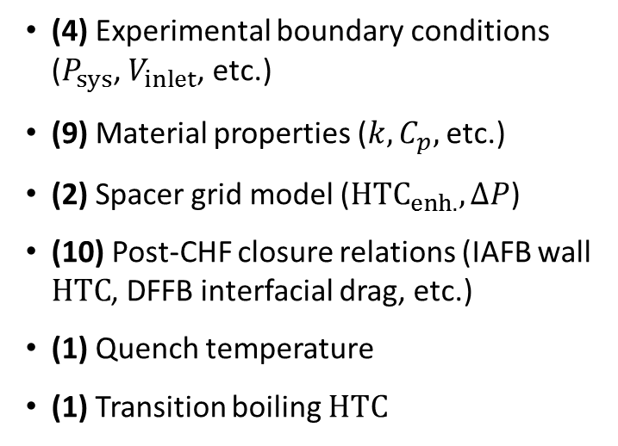
Scope of Research: TRACE Model of FEBA SETF
Backpressure
27 Parameters are required to specify the model:
(4) Experimental boundary conditions ($P_{sys}$, $V_{inlet}$, etc.)
(9) Material properties ($k,C_{p},$etc.)
(2) Spacer grid model ($HTC_{enh.},ΔP$)
(10) Post-CHF closure relations (IAFB wall $HTC$, DFFB interfacial drag, etc.)
(1) Quench temperature
(1) Transition boiling $HTC$
Upper plenum
Controllable inputs $x_{c}$
Model
parameters $x_{m}$
Powered Heater Rods
With flat independent prior uncertainties, either in linear or log scales
Housing/Enclosure
Spacer grid
Inlet flow
Notes:
The method is adapted and demonstrated directly to solve this problem.
The problem is used in the OECD/NEA PREMIUM Benchmark

Slide 11
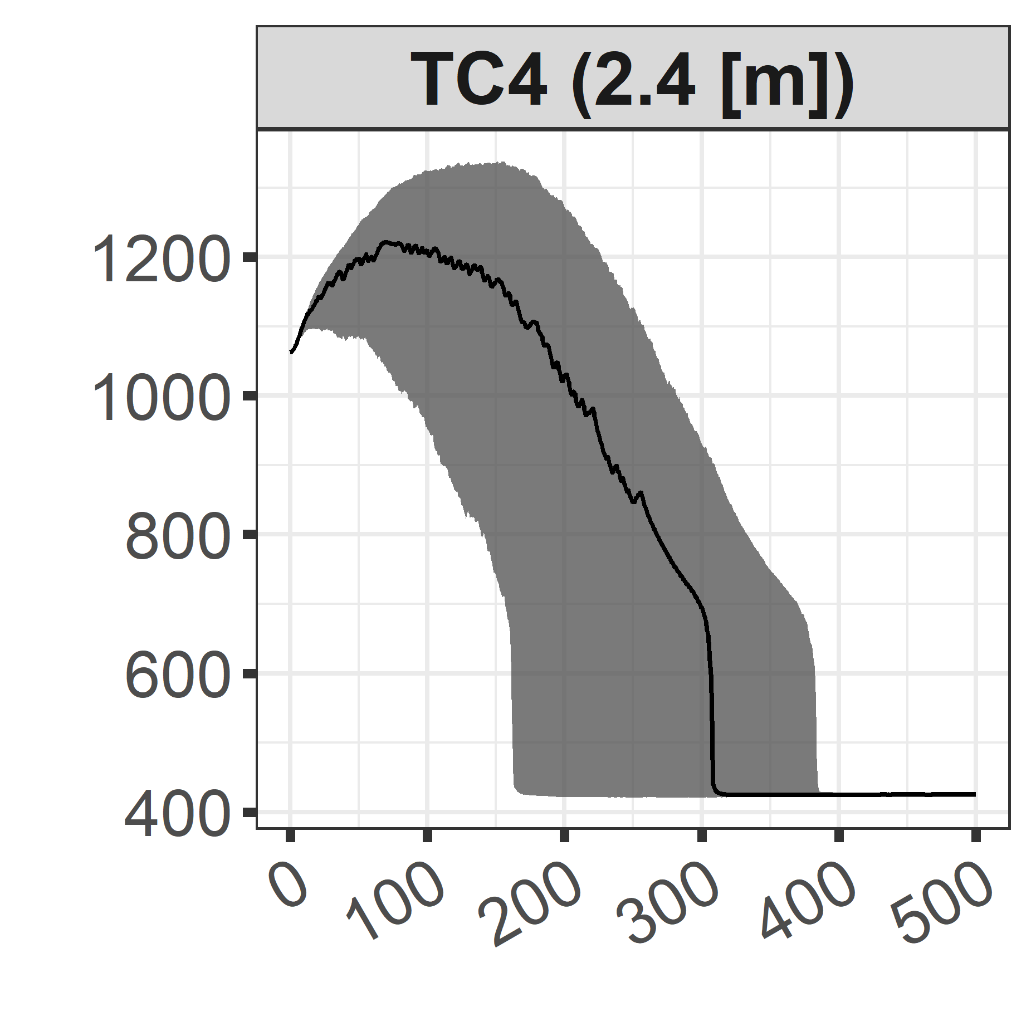
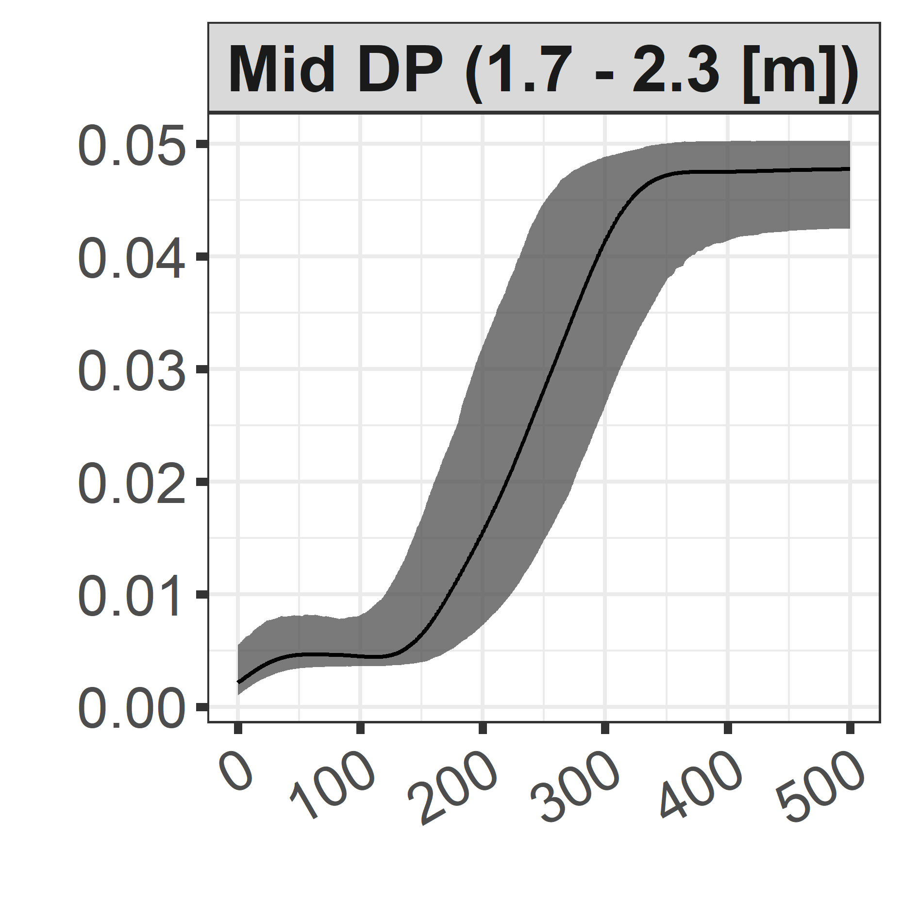
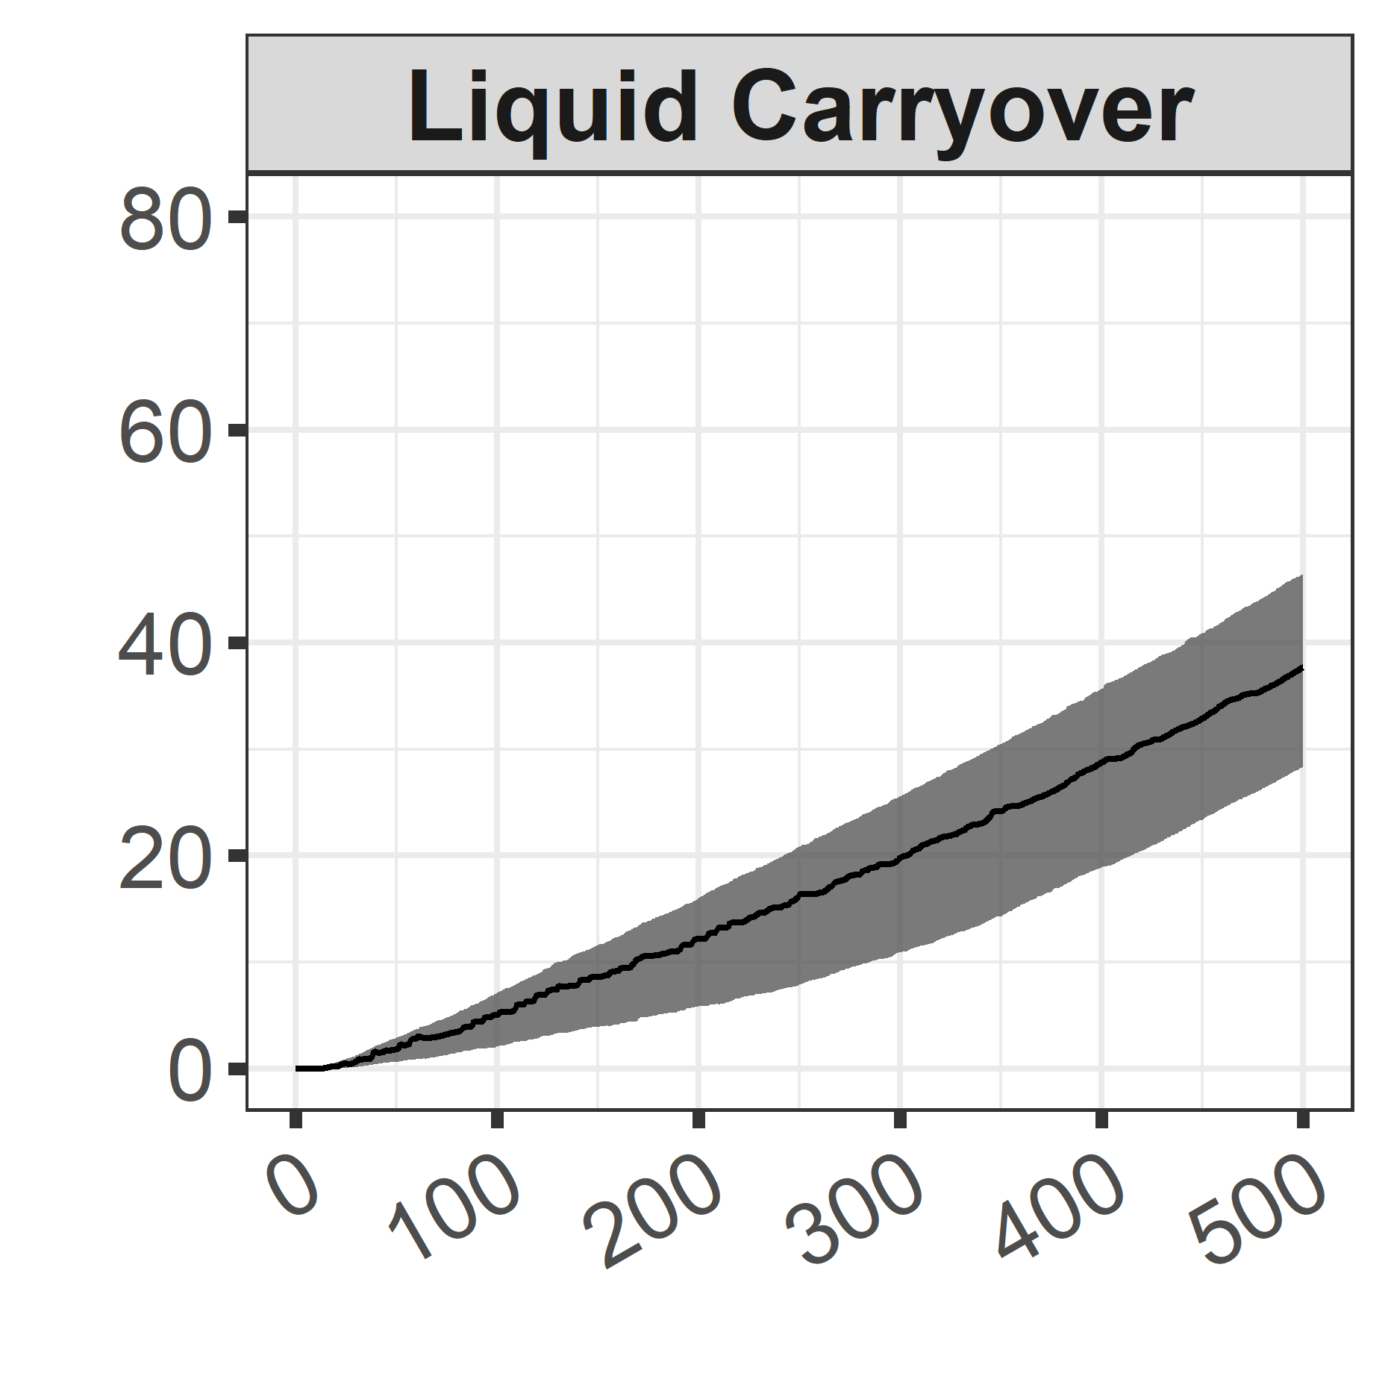
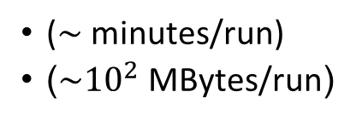
Statistical Framework: Outline
How to select important parameters to be inferred?
Global Sensitivity Analysis
27 initial parameters
Which parameters are (not) influential?
For influential parameters, how parameters affect the output and by how much?
How to approximate the input/output of the forward model?
Gaussian Process Metamodeling
($\sim$minutes/run)
($\sim {10}^{2}$MBytes/run)
How to make the inference (quantification)?
Clad Temperature [K]
Bayesian Calibration
Pressure Drop [bar]
Liquid Carryover [kg]
Is the quantified uncertainty useful?
Uncertainty Propagation
Time [s]
Notes:
Uncertainty propagation using prior pdfs and 1’000 samples. Bands are constructed based on the 95% probability (2.5th – 97.5th percentile).

Slide 12
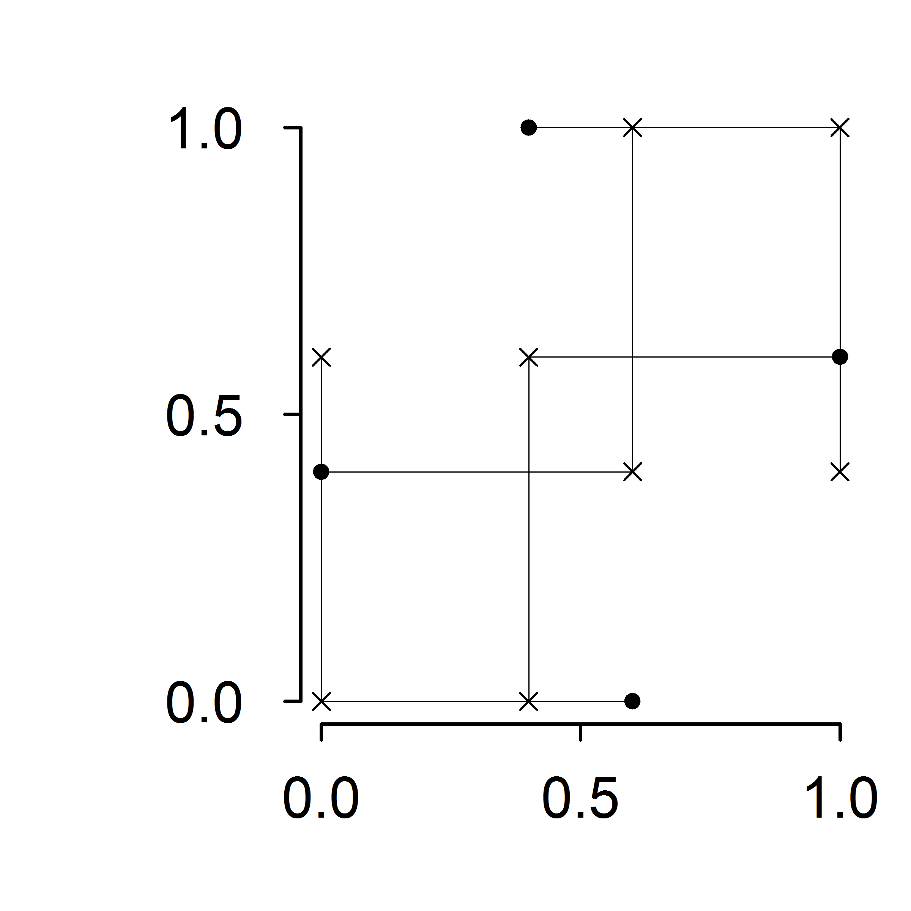
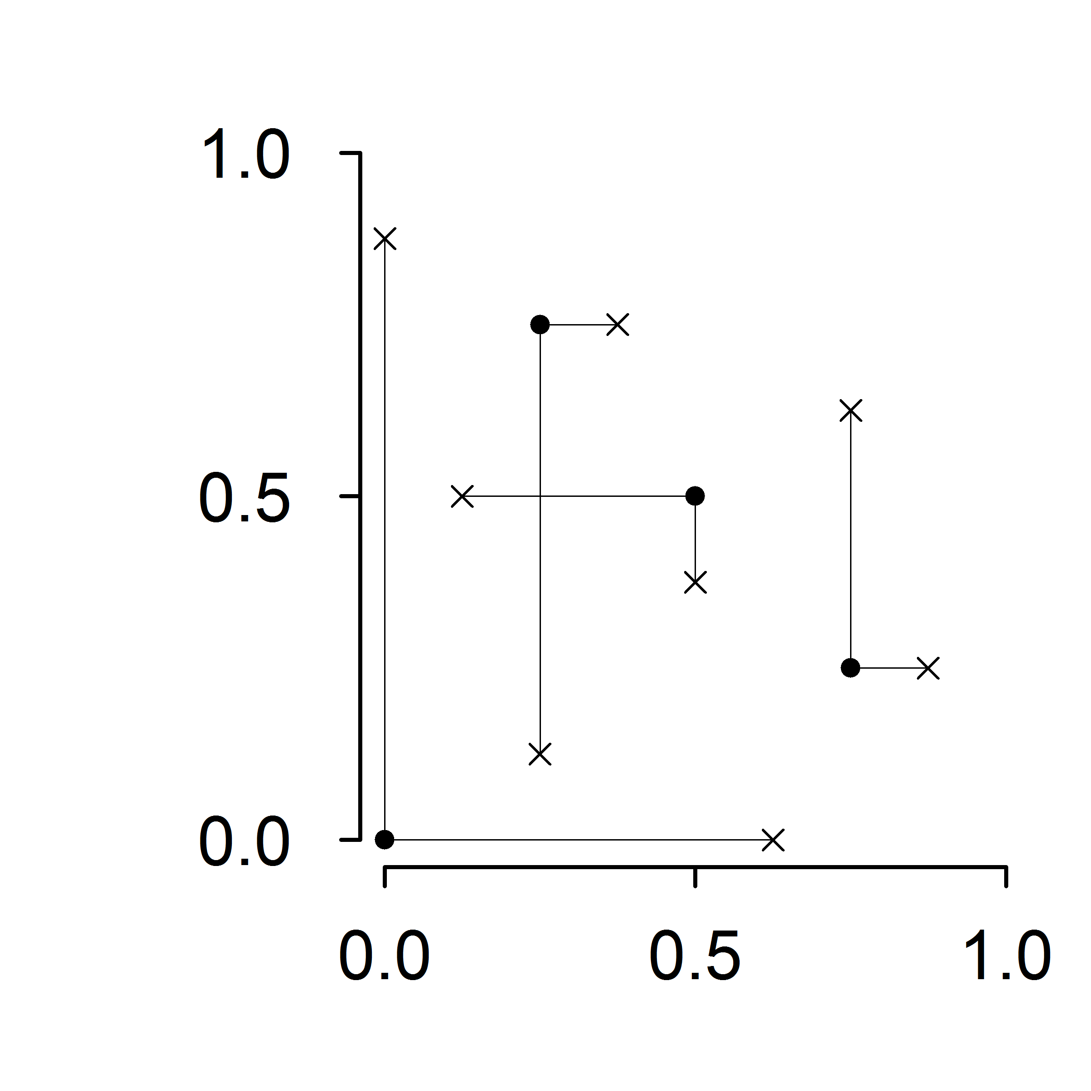


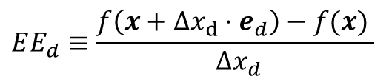

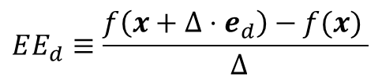

Global Sensitivity Analysis for Screening: The Morris Screening Method
Elementary effect $EE_{d}$ is the effect of a parameter perturbation on the output
$$EE_{d}≡\frac{f\left(x+Δ⋅e_{d}\right)−f(x) }{ Δ}$$
$$EE_{d}≡\frac{f\left(x+Δx_{d}⋅e_{d}\right)−f(x) }{ Δx_{d}}$$
Perturbation of one parameter at a time
Trajectory Scheme
Radial Scheme
Illustrations for 2 parameters and 4 replications
$$x_{2}$$
$$x_{2}$$
Base / starting points
Perturbed points
$$x_{1}$$
$$x_{1}$$

Slide 13
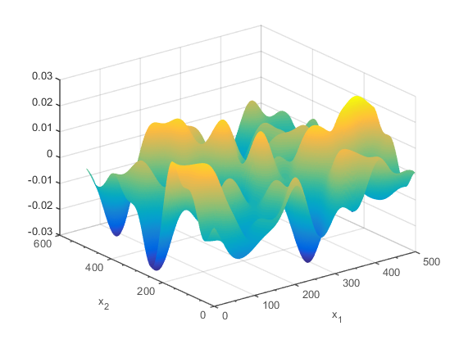
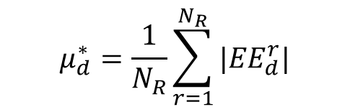
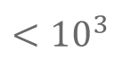
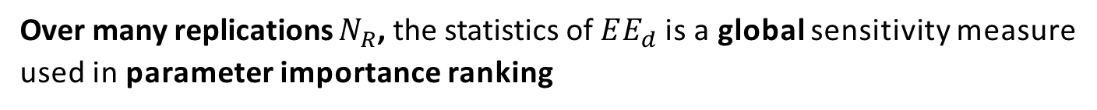

Global Sensitivity Analysis for Screening: The Morris Screening Method
Elementary effect $EE_{d}$ is the effect of a parameter perturbation on the output
$$EE_{d}≡\frac{f\left(x+Δ⋅e_{d}\right)−f(x) }{ Δ}$$
$$EE_{d}≡\frac{f\left(x+Δx_{d}⋅e_{d}\right)−f(x) }{ Δx_{d}}$$
Perturbation of one parameter at a time
Over many replications $N_{R}$, the statistics of $EE_{d}$is a global sensitivity measure used in parameter importance ranking
A complex model
$$μ_{d}^{∗}=\frac{1}{N_{R}}\sum_{r=1}^{N_{R}}{{|EE}_{d}^{r}|}$$
Mean of absolute value
$$<{10}^{3}$$
Computation cost (Code runs)
$$N=N_{R}×(D+1)$$
# of parameters
Notes:
The idea of global method is that we don’t use many assumptions regarding the input/output hyper-surface. Perturbation from one point might give different results compared to the perturbation from another point.
We evaluate the input over range that is wide that might cause departure from a well behaved response
But Morris is qualitative (ordinal) does not intuitively tell how important a parameter is.

Slide 14
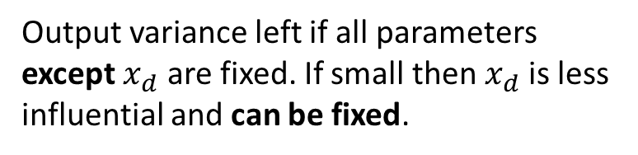
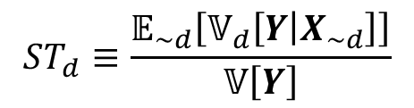
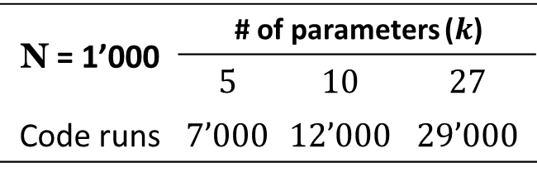
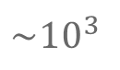

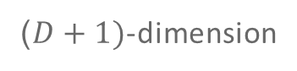

Global Sensitivity Analysis for Screening: Sobol’ Total-Effect Indices
Sobol’ total-effect index for parameter $x_{d}$:
Output variance left if all parameters except $x_{d}$ are fixed. If small then $x_{d}$is less influential and can be fixed.
$$ST_{d}≡\frac{𝔼_{\sim d}\left[𝕍_{d}\left[Y | X_{\sim d}\right]\right]}{𝕍\left[Y\right]}$$
Written in integral form:
($D+1)$-dimension
$$ST_{d}≡ \frac{\int{f^{2}}\left(x\right) dx−\int{\int{f\left(x_{\sim d},{x_{d}}_{}^{′}\right) f\left(x_{\sim d},x_{d}\right) d{x_{d}}_{}^{′}d}}x}{\int{f^{2}}\left(x\right) dx−{\left(\int{f}\left(x\right) dx\right)}^{2}}$$
Computed by Monte Carlo estimation with cost (code runs):
$$\sim {10}^{3}$$
N = 1’000 | # of parameters ($k$)
 | $$5$$ | $$10$$ | $$27$$
Code runs | $$7’000$$ | $$12’000$$ | $$29’000$$
$$N=N_{R}×(D+2)$$
# of parameters

Slide 15






Global Sensitivity Analysis for Screening: Comparison of Methods
Selected Quantity of Interest: Time-Average Output
Boundary conditions, closure laws, and spacer grid model parameters are relatively influential (12 parameters) based on $5\%$ total-effect indices cut-off
$320$ replications $=8^{′}960$runs
$1^{′}000$ samples $={29}^{′}000$runs
Sensitivity Measure
Number of Replications / Samples
Notes:
The three screening methods give (more/less) consistent ranking
But you don’t actually need to run all the way through

Slide 16



Uncertainty Propagation using Influential vs. Non-Influential Parameters
Uncertainty propagation using 2 parameter subsets and 500 Monte Carlo samples
Clad Temperature [K]
Pressure Drop [bar]
Liquid Carryover [kg]
Time [s]
Parameter subsets
12 Influential
15 Non-influential

Slide 17

Statistical Framework
How to select important parameters to be inferred?
Global Sensitivity Analysis
27 initial parameters
12 influential parameters
How to approximate the input/output of the forward model?
Gaussian Process Metamodeling
($\sim$minutes/run)
($\sim {10}^{2}$MBytes/run)
How to make the inference (quantification)?
Bayesian Calibration
Is the quantified uncertainty useful?
Uncertainty Propagation
Notes:
To answer those questions, we adapt and implement statistical methodologies derived from applied statistics especially related to the design and analysis of computer experiments.
This will also serve as the outline for the rest of the presentation we will start answering these questions one by one using a running example of TRACE model.
And we don’t develop codes, it is worthwhile to develop methods that is applied outside the code implementation.

Slide 18
Statistical Framework

Slide 19








Gaussian Process
Common variance
Gaussian process is Gaussian with infinite variates:$y\left(\underline{θ}\right)∈ℝ;\underline{θ}∈ℝ^{K}$
$$f\left(y\left(\underline{θ}\right)\right)\sim GP\left(m(\underline{θ}), σ^{2}k\left(\underline{θ},{\underline{θ}}^{∗}\right)\right)$$
correlation function
power-exponential correlation
Probability Distribution over function (of$\underline{θ}$) values
Mean function, the usual: zero, constant, linear, etc.
$$k\left(\underline{θ},{\underline{θ}}^{∗}\right)≡Cov\left[y,y^{∗}\right]=\prod_{k=1}^{K}{\exp\left[−{\left(\frac{{|θ}^{\left(k\right)}−θ^{∗\left(k\right)}|}{η^{\left(k\right)}}\right)}^{α^{(k)}}\right]}$$
multi-parameters construction
correlation length
power parameter
Used in Bayesian Non-linear Regression
Learn about $η^{(k)}$and $α^{\left(k\right)}$
Prior
Data
Posterior

Slide 21


Slide 22

The training sample size is the main factor for the metamodel performance
Training Sample Size
Major impact
Design of Experiment
Minor impact
Covariance Kernel Functions
Negligible impact

Slide 23
Statistical Framework
How to select important parameters to be inferred?
Global Sensitivity Analysis
27 initial parameters
12 influential parameters
How to approximate the input/output of the forward model?
Gaussian Process Metamodeling
($\sim$minutes/run)
($\sim {10}^{2}$MBytes/run)
How to make the inference (quantification)?
Bayesian Calibration
Is the quantified uncertainty useful?
Uncertainty Propagation
Notes:
To answer those questions, we adapt and implement statistical methodologies derived from applied statistics especially related to the design and analysis of computer experiments.
This will also serve as the outline for the rest of the presentation we will start answering these questions one by one using a running example of TRACE model.
And we don’t develop codes, it is worthwhile to develop methods that is applied outside the code implementation.

Slide 24
Statistical Framework
How to select important parameters to be inferred?
Global Sensitivity Analysis
27 initial parameters
12 influential parameters
How to approximate the input/output of the forward model?
Gaussian Process Metamodeling
($\sim$minutes/run)
($\sim {10}^{2}$MBytes/run)
How to make the inference (quantification)?
Bayesian Calibration
Is the quantified uncertainty useful?
Uncertainty Propagation
Notes:
To answer those questions, we adapt and implement statistical methodologies derived from applied statistics especially related to the design and analysis of computer experiments.
This will also serve as the outline for the rest of the presentation we will start answering these questions one by one using a running example of TRACE model.
And we don’t develop codes, it is worthwhile to develop methods that is applied outside the code implementation.

Slide 25
Wir schaffen Wissen – heute für morgen
This is an example of a summary on a final slide: at PSI we use synchrotron light to look into magnetic materials and thus …
… understand the details of the nanoworld in order to optimise technology.
… understand the interaction between new materials.
… maybe discover new nanomagnets.

Slide 26
Wir schaffen Wissen – heute für morgen
Thank you for your attention.
My sincere gratitude to:
Prof. A. Pautz
Mr. O. Zerkak
Dr. G. Perret
Mr. Ph. Jacquemoud
Dr. M. Hursin
Dr. D. Rochman
Mr. H. Ferroukhi
Other members of STARS
The jury members:
Prof. R. Houdré
Dr. J. Baccou
Dr. W. Zwermann
Prof. B. Sudret
Additional acknowledgments:
Swiss Federal Nuclear Safety Inspectorat (ENSI)
Swiss Federal Office of Energy (BFM)

Slide 27







ETHZ-EPFL MSc in Nuclear Engineering
Swiss joint MSc program between ETHZ and EPFL
Established in 2008, more than 100 students
Two-year program, 120 ECTS credits
Students attend two top-ranked universities:
ETH Zurich #9
EPF Lausanne #14 (based on QS)
Scientific support and research at the Paul Scherrer Institute
Grants and scholarships available
Notes:
The Swiss Master of Science in Nuclear Engineering program is the only joint program between the Swiss Federal Institutes of Technology in Zurich and Lausanne (ETHZ and EPFL).
It was created in 2008 and after 8 years more than 100 students have successfully attended the master program.
The program lasts two years (equivalent to 120 European Credit Transfer & Accumulation System credits), and the students attend two of the best universities with world-wide reputation; ETHZ which ranks at the 9th position and the EPFL which ranks on the 14th position based on the QS university ranking system for 2016.
The students receive a continuous strong scientific support from top level scientists of the Paul Scherrer Institute (the Swiss federal multi-disciplinary research center for natural sciences and technology).
Numerous scholarships, accommodation & travel grants and allowances are available for the students. For example, all students have in the past received mobility grants.
On the right hand side pictures you can see (from top to bottom) the legendary central building of ETH in Zurich, the innovative campus of EPFL with the Rolex Learning Center next to the Geneva lake, and the traditional Swiss landscape where the PSI is located alongside the Aare river.
The central picture shows the location of EPFL, ETHZ and PSI on the map of Switzerland, right in the heart of Europe.

Slide 28






ETHZ-EPFL MSc in Nuclear Engineering
Curriculum focuses on:
Neutronics
Thermohydraulics
Nuclear Material Science
Nuclear Safety
Waste Management
Radiation Protection
…and more
Unique world-class facilities:
CROCUS research reactor
Swiss Light Source synchrotron
Hot Lab facility
Proton therapy center
Numerous TH experimental facilities
Curriculum includes:
Three-month industrial internship
Research project
Master thesis
Notes:
The curriculum of the Swiss Master Program in Nuclear Engineering covers many areas of Nuclear Engineering. A plethora of courses in neutronics, thermohydraulics, nuclear material science, nuclear safety, waste management, radiation protection and others, are provided and taught by top level Professors and scientists from EPFL, ETHZ and PSI.
The students have the opportunity to get trained and perform hands-on work on unique world-class facilities, like:
the CROCUS zero power education and research reactor at EPFL.
the Swiss Light Source (SLS) at PSI, a 3rd generation synchrotron light source with an energy 2.4 GeV which provides photon beams of high brightness for research in materials science, biology and chemistry.
the Hot Lab facility, the only Swiss laboratory authorized by the safety authorities to handle large quantities of radioactive materials including commercial as well as experimental nuclear fuel.
the Proton Therapy Center at PSI, the worldwide first compact scanning gantry for the irradiation of deep-seated tumors with proton beam.
numerous Thermohydraulic facilities at ETHZ and PSI, focusing on fast neutron imaging, large scale investigation of natural circulation, bubble experiments, aerosol generation, etc.
and others.
Finally during the last year of the studies, the students have to perform
a 3-month internship at the Swiss nuclear industry [nuclear power plants (KKG, KKL, KKB, KKM), nuclear utilities (Axpo, Alpic, BKW, etc.), regulatory body (ENSI), etc.]. Students have the possibility to do their internship also abroad.
a research project at PSI and a 6-month master thesis project (at PSI, ETH, EPFL, or in industry) which complete the curriculum.

Slide 29






ETHZ-EPFL MSc in Nuclear Engineering
For more information visit master-nuclear.ch
Notes:
For the first 8 years of the master program, more than 100 students have followed nuclear engineering studies in Switzerland.
The program has a very international character, with the students coming from 30 different countries across the globe, and from 44 different universities.
the majority of the students come from France (15%), China (14%) and Switzerland (10%).
The structure of the program receives a very positive feedback, as 94% of the students have stated that they are (very) satisfied with the program.
After their graduation, 83% of the graduates remain in the nuclear field and 62% of the graduates continue their career in Switzerland.
Finally, it is worth noting that both ETHZ and EPFL have very low tuition fees (600 euros per semester) for all students (Swiss and non-Swiss).
For more information you can visit the official web-site of the master program (master-nuclear.ch)

